Slide 1
Network Research: Effects of Contexts and Opportunity Structures on Ego Networks

Slide 2
Segregation and constraints in networks
Smaller “core” networks are socially segregated
  Homophily by race, ethnicity, political affiliation, religion, etc.
But are larger “acquaintance” networks equally segregated?
  Maybe “core” networks serve to “bond” and larger acquaintance networks serve to “bridge”
    Putnam (2000)

Slide 3
Segregation and constraints in networks
Smaller “core” networks are socially segregated
  Homophily by race, ethnicity, political affiliation, religion, etc.
But are larger “acquaintance” networks equally segregated?
  However, recent work (DiPrete et al 2011) seems to suggest that “larger” acquaintanceship networks are also segregated!
    Why?

Slide 4
Segregation and constraints in networks
Why do ego-networks remain segregated?
  Contextual and socio-psychological constraints work together
Building on last discussion need to dissociate constraints at different dyadic stages:
  Formation
  Maintenance
  Decay
Formation
Constraints on...
Maintenance
Decay

Slide 5
Segregation and constraints in networks
Why do ego-networks remain segregated?
  Contextual and socio-psychological constraints
Leads to three different type of answers:
  What constrains relations to form with similar others?
  What constrains people to maintain relations to similar others?
  What constrains relations with similar other from being dissolved?
Formation
Constraints on...
Maintenance
Decay

Slide 6
Segregation and constraints in networks
Lazarsfeld/Merton rule
  Preferences for similar (dissimilar) others leads to segregated (non-segregated) networks
Blau’s rule
  Numerical preponderance (scarcity) of similar others leads to segregated (non-segregated) networks
    Independently of preferences
Feld’s rule
  Segregated (non-segregated) foci lead to segregated (non-segregated) networks
    Independently of preferences and group size differences
Mehra’s rule
  Being in an extreme minority enhances preferences for similar others
    Partially overriding Blau’s rule and independently of foci segregation

Slide 7
Segregation and constraints in networks
Individual
Preference
(Choice Homophily)
Constraints on Formation
Ego-Network Size
Numerical
(Group Size)
Structural
Segregated Foci
Triadic Closure
(Balance)

Slide 8
Segregation and constraints in networks
Individual
Preference
(Choice Homophily)
Constraints on Formation
Ego-Network Size
Numerical
(Group Size)
Structural
Segregated Foci
Triadic Closure
(Balance)

Slide 9
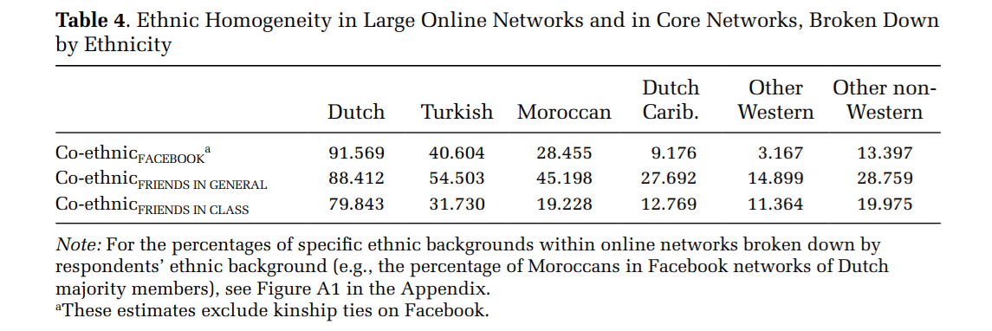
Segregation and constraints in networks
Constraints on Formation
Structural
Numerical
(Group Size)

Slide 10
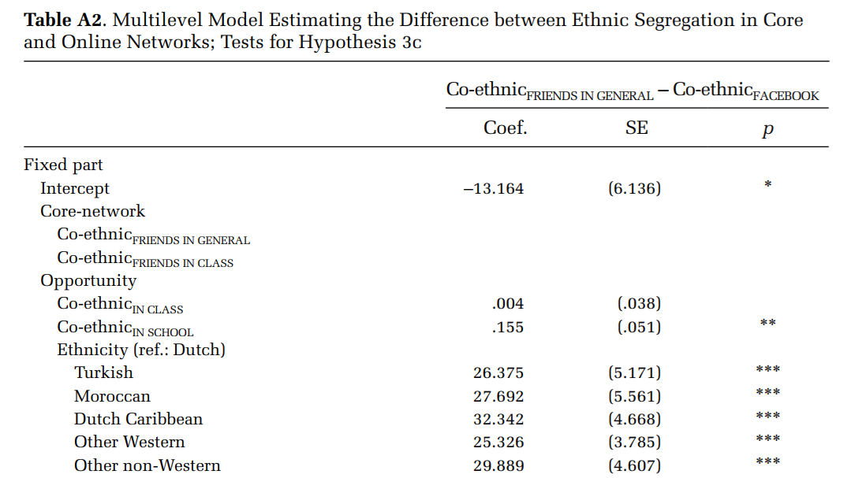
Segregation and constraints in networks
Individual
Constraints on Formation
Preference
(Choice Homophily)
Structural
Numerical
(Group Size)

Slide 11
Segregation and constraints in networks
Individual
Preference
(Choice Homophily)
Constraints on Formation
Ego-Network Size
Numerical
(Group Size)
Structural
Segregated Foci
Triadic Closure
(Balance)

Slide 12
Segregation and constraints in networks
Individual
Preference
(Choice Homophily)
Constraints on Formation
Ego-Network Size
Numerical
(Group Size)
Structural
Segregated Foci
Triadic Closure
(Balance)

Slide 13
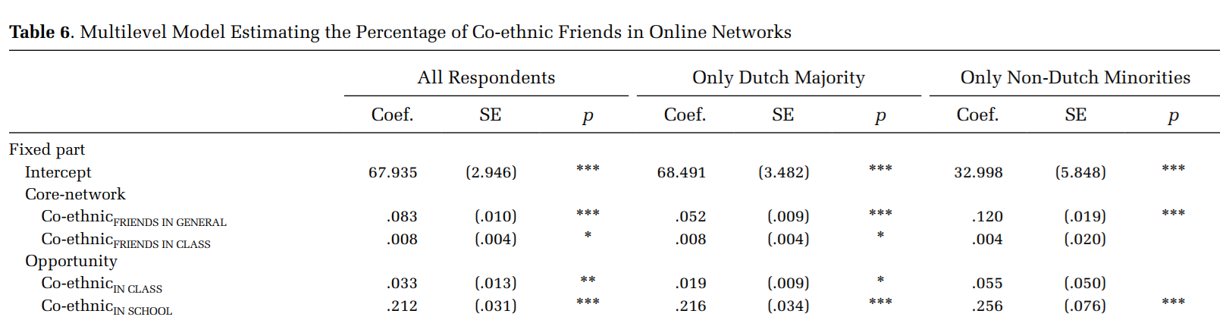
Segregation and constraints in networks
Constraints on Formation
Structural
Triadic Closure
(Balance)

Slide 14
Segregation and constraints in networks
Constraints on Formation
Structural
Segregated Foci

Slide 15
Segregation and constraints in networks
Individual
Preference
(Choice Homophily)
A
Constraints on Formation
Ego-Network Size
Numerical
(Group Size)
Structural
Segregated Foci
B
Triadic Closure
(Balance)

Slide 16
Segregation and constraints in networks
Individual
Preference
(Choice Homophily)
A
Constraints on Formation
Ego-Network Size
Numerical
(Group Size)
Structural
Segregated Foci
B
Triadic Closure
(Balance)

Slide 17

Segregation and constraints in networks
A
B

Slide 18
Segregation and constraints in networks
Blau’s rule
  Numerical preponderance (scarcity) of similar others leads to segregated (non-segregated) networks
    Independently of preferences
Marsden’s rule
  Larger networks are less segregated than smaller networks
    Independently of preferences
Hofstra et al’s rule
  Larger networks are less segregated for minority members
    Independently of preferences
      Combines Blau’s and Marden’s rule

Slide 19
Segregation and constraints in networks
Constraints on tie-maintenance are analytically distinct from formation constraints
  Explains why particular ties are more likely to remain
Constraints on tie formation presumes that we form ties with people with like
  There is a link between “role relations” (e.g. friends), exchange, frequency of interaction and sentiments
Assumption:
  If a tie no longer delivers on these dimensions it is dissolved
  Makes the existence of ties with “inconsistent” values on these dimension hard to explain
    E.g. negative sentiment ties that still provide support and exchange

Slide 20
Segregation and constraints in networks
Constraints on tie-maintenance are analytically distinct from formation constraints
  Explains why particular ties are more likely to remain
Constraints on tie formation presumes that we form ties with people with like
  There is a link between “role relations” (e.g. friends), exchange, frequency of interaction and sentiments
Studying stable ties with inconsistent dimensions (e.g. “difficult” ties) can help us learn about relationship maintenance mechanisms

Slide 21
Segregation and constraints in networks
Dyadic
(Reciprocity)
Interactional
Dyadic
(Dependence)
Constraints on maintenance
Triadic
(Embeddedness)
Social Foci
Structural
Role-Based

Slide 22
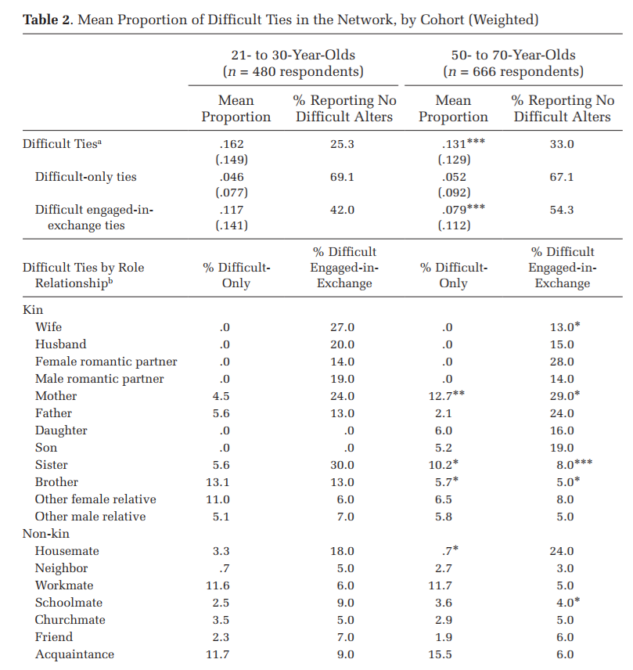
Segregation and constraints in networks
Constraints on maintenance
Social Foci
Structural
Role-Based

Slide 23
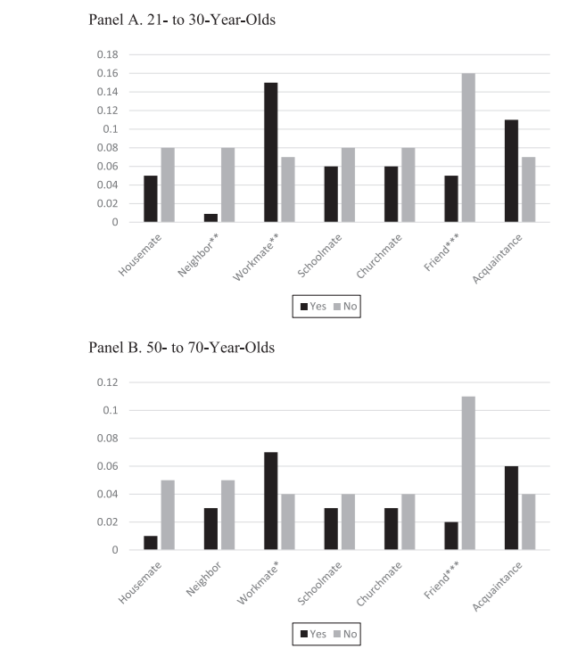
Segregation and constraints in networks
Constraints on maintenance
Social Foci
Structural
Role-Based

Slide 24
Segregation and constraints in networks
Brashear’s rule:
  Ties embedded in constraining foci will be maintained
    Independently of sentiments
Offer and Fischer’s rule:
  Ties to others in constraining role relations will be maintained
    Independently of sentiments
Dependence and reciprocity do not seem to play a role in the maintenance of difficult ties
  Role may be restricted to ties in which sentiments and other dimensions are consistent

Slide 25
Segregation and constraints in networks
Triadic
(Embeddedness)
Constraints on maintenance for
“Inconsistent” Ties
Structural
Social Foci
Role-Based

Slide 26
Segregation and constraints in networks
Individual
Ego-Network Size
Constraints on Decay
Interactional
Similarity
Structural
Shared Foci
Reciprocity
Triadic Closure
(Simmelian Ties)

